Slide 1
Time Series Concepts From Scratch
Divyanshu Vyas
Data Scientist | Math Inhaler

Slide 2
1. Unit Roots
They’re something that “Get in the way” of us modelling a Time Series.
If a time series has a unit root - It means it IS NOT STATIONARY and we gotta do something about it - a bare minimum : keep a note that it has a unit root.
The presence of Unit root makes AR/MA/ARMA modelling less easy/less straight forward and calls for other forms of analysis.
THE REAL PROBLEM with them is that : A Time Series having a Unit Root, might visually still look stationary, more often than not! and they need further mathematical digging to find out they have URs and hence Non-Stationary.

Slide 3
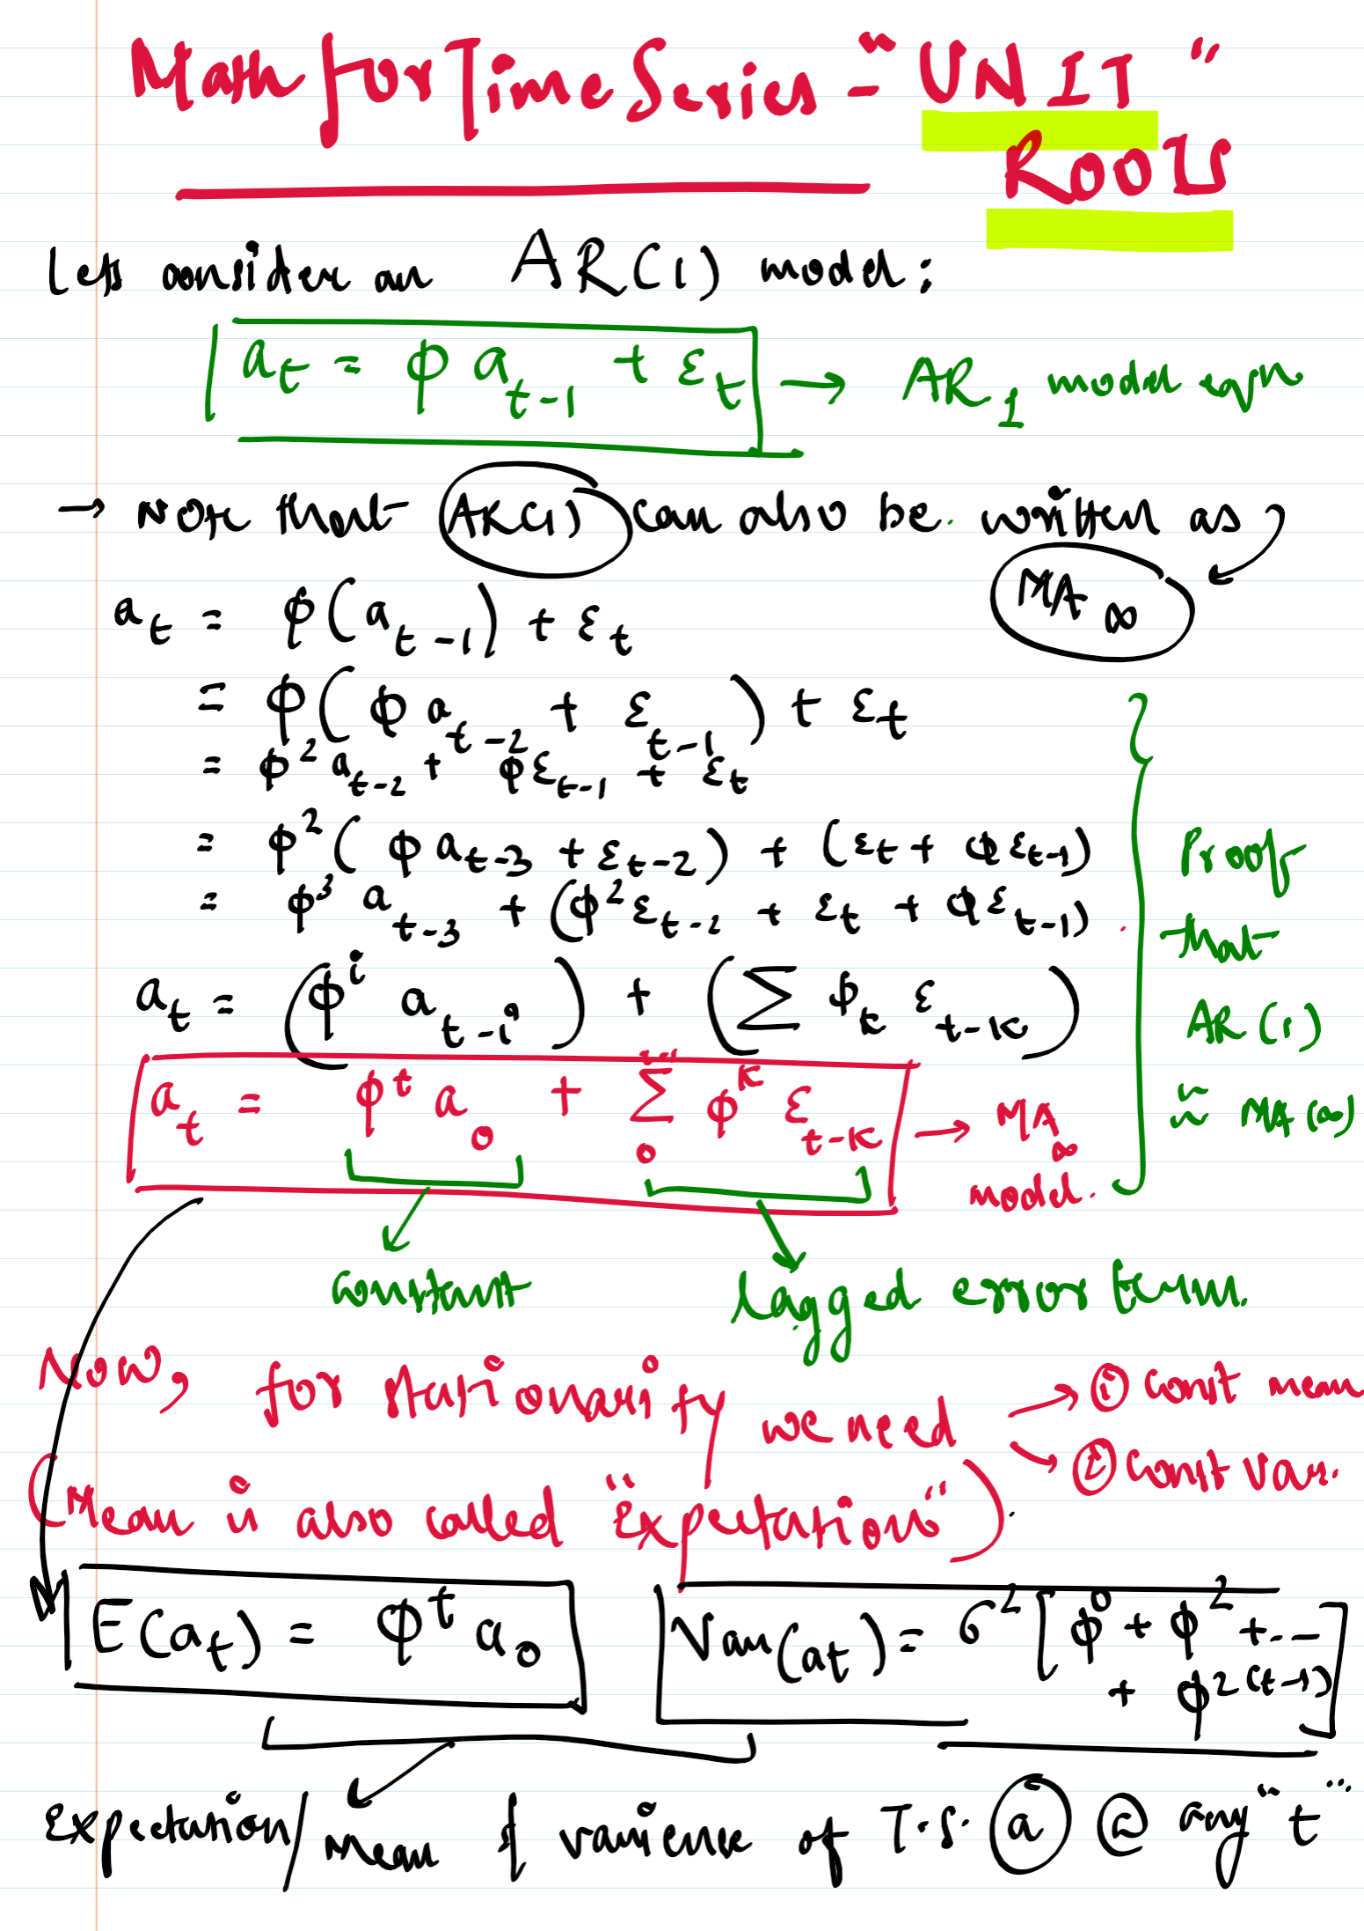
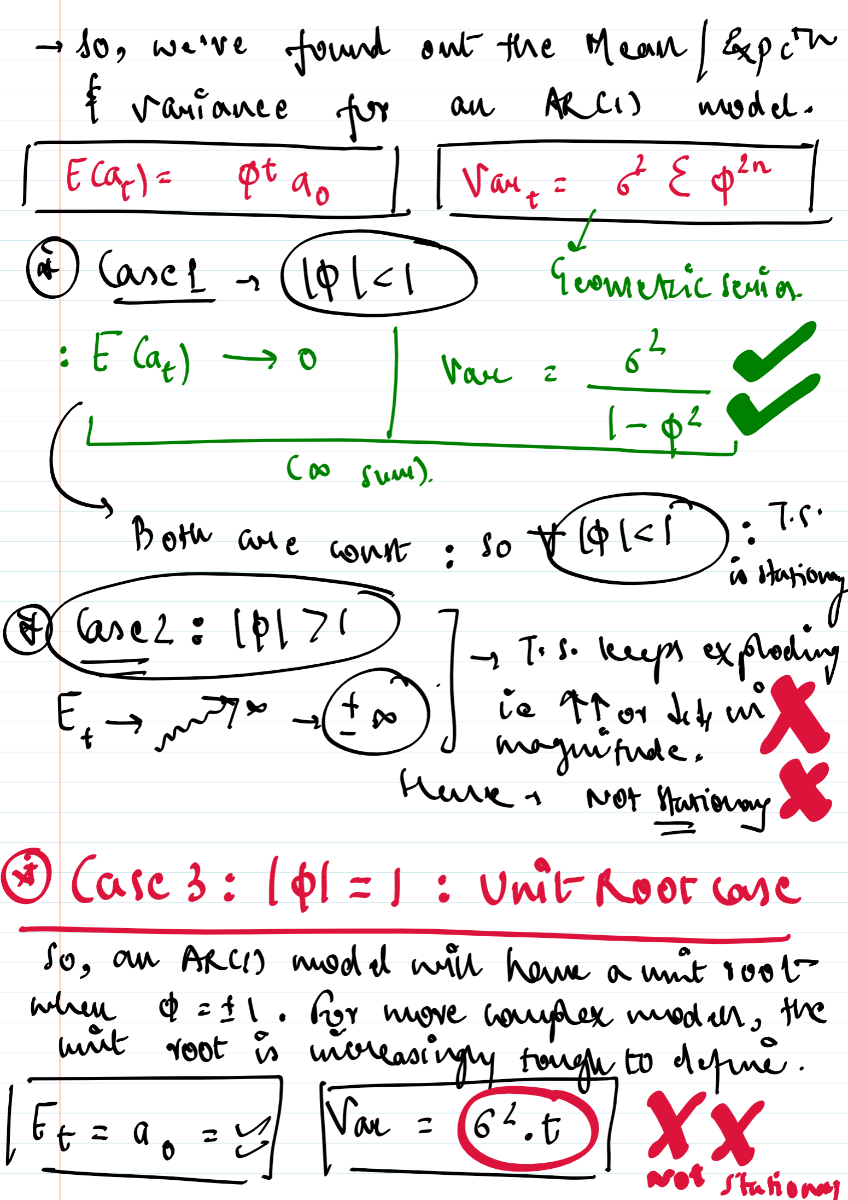
1
2
2.
Some Math
to Understa-nd
Unit roots for an AR(1) model

Slide 4
3. Unit Roots - further notes
So basically, following are the conclusions :
Unit root can exist for any T.S and make it unstationary - need to detect it and apply necessary transformations before modelling.
In AR1 model : UR can be handled by first differencing.
In other complex TS Models : We might need robust techniques like Dickey Fuller Test to find the existence of a Unit Root.
In Summary : A UR is a mathematical reason due to which either the Mean or the Variance of a Time Series varies over time and hence the Time Series becomes unstationary : even though visually it might very often look stationary.
It might require us to do additional checks and additional transformations to handle the UR induced Non-Stationarity before we proceed to modelling.

Slide 5
Thanks, more mini-books on the way!
Much of my learning credits : Ritvik Math on YouTube
Happy Learning!
For More : Follow Petroleum From Scratch on YouTube

